Slide 1


Formulating Questions
1. Do you use your cell phone daily for voice calls (yes or no), to access the internet, or send text messages? ⃝ Yes ⃝ No
Key Points
Ask questions that apply to everyone
Ask one question at a time
Line length of 3-5 inches
Clear separation of question and answer options
Do not embed the response options into the question stem
Consider using uniquely shaped answer spaces to distinguish between different types of questions
1. Do you use a cell phone?
No
Yes
2. (If yes) Do you use your cell phone at least daily for each of the following. Check all that apply.
For voice calls
To access the internet
To send text messages

Slide 2
Poor Example:
Improved Example:

Slide 3
Poor Example:
An Improved Example:
Best Example:
1. Do you use your cell phone daily for voice calls (yes or no), to access the internet, or send text messages? ⃝ Yes ⃝ No
1. Do you use a cell phone?
No
Yes
2. (If yes) Do you use your cell phone at least daily for each of the following. Check all that apply.
For voice calls
To access the internet
To send text messages
1. Do you use a cell phone?
No Go to question 2
Yes
1a. (If yes) Do you use your cell phone at least daily for each of the following:
For voice calls
To access the internet
To send text messages
Yes No
⃝ ⃝
⃝ ⃝
⃝ ⃝
Key points:
Ask questions that apply to everyone
Ask one question at a time
Clear separation of questions & answers
Consider using uniquely shaped answer spaces to distinguish between different types of questions
Key points:
Use arrows and visual cues to provide a clear navigational path
Also, indented and labeled 1a
Use forced choice-responses, as opposed to check-all-that-apply

Slide 4
Formulating Questions
1. Do you use your cell phone daily for voice calls (yes or no), to access the internet, or send text messages? ⃝ Yes ⃝ No
A better revision:
1. Do you use a cell phone?
No Go to question 2
Yes
Key Points
Use arrows and visual cues to provide a clear navigational path
Also, indented and labeled 1a
Use forced choice-responses, as opposed to check-all-that-apply
1a. (If yes) Do you use your cell phone at least daily for each of the following:
For voice calls
To access the internet
To send text messages
Yes No
⃝ ⃝
⃝ ⃝
⃝ ⃝

Slide 5
Formulating Questions
2. To what extent do you agree that your
instructors are accessible outside of class?
Significantly agree
Strongly agree
Agree
Neutral
Disagree
Strongly disagree
2. How accessible or inaccessible are your instructors outside of class?
Very accessible
Somewhat accessible
Neutral
Very inaccessible
Somewhat inaccessible
1
1
2
2
3
3
4
4
5
5
6
Key Points
Reduce complexity - question stem and response options should match
Provide balanced scales – categories should be relatively equal distance apart
Avoid having too many response options – may become difficult to differentiate
Use positive and negative side in question stem; for unipolar scales use “if at all”
Do not include or minimize salience of elements not important for respondents
Notes:
Note to remember during presentation:
For bipolar scales (e.g. questions asking for agreement and disagreement), 5 to 7 categories may be ideal.
For unipolar scales (e.g. questions asking about level of concern), 4 to 5 may be ideal.

Slide 6
Formulating Questions
3. Times you ate together with the occupants of this household?
___________________________
3. How many meals did you sit down to eat at home as a family last week?
Number of meals
Key Points
Use complete sentences
Use specific, concrete language – do not allow room for interpretation
Use simple, familiar language – avoid abbreviations or specialized language
Encourage use of desired response types by providing appropriately sizes response fields and labels close to response field

Slide 7
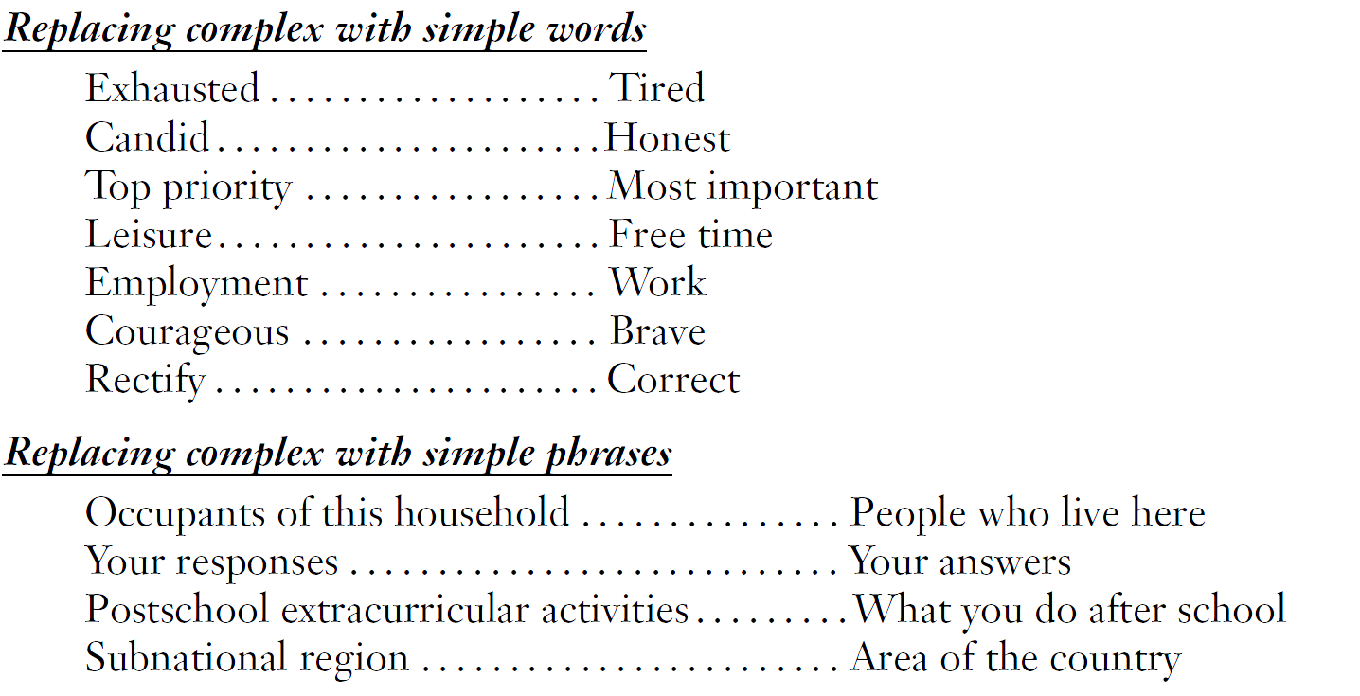
Use Simple, Familiar Language

Slide 8
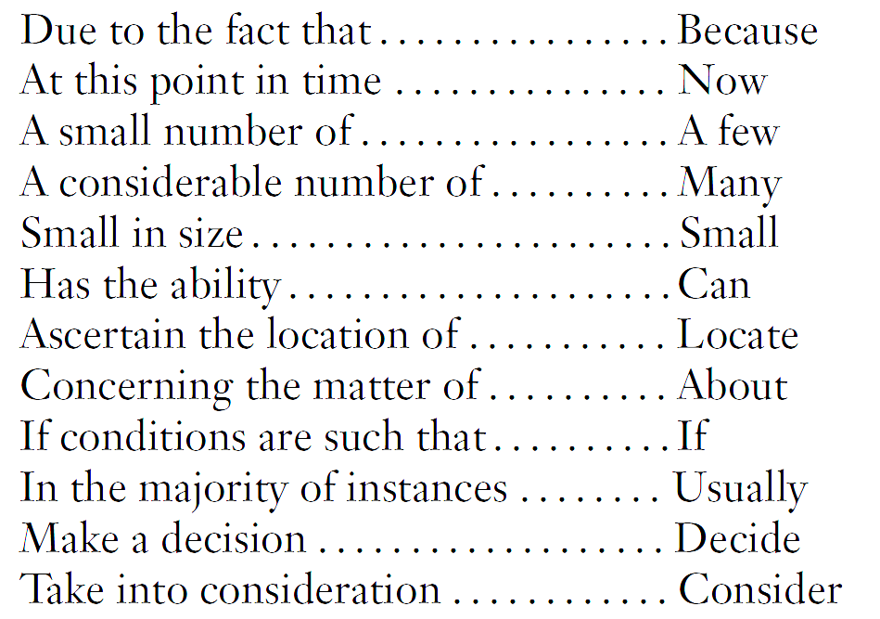
Use Few Words to Pose Questions
4. How many people were living or staying at this residence on Saturday March 3rd, 2000? To make sure each person in the United States is counted only once, it is very important to:
Include everyone who lives here whether related
to you or not, and anyone staying temporarily who
has no permanent place to live;
But do not include anyone away at college,
away in the Armed Forces, in a nursing home,
hospice, mental hospital, correctional facility,
or other institution.
Avoid Wordy Expressions
Number people at residence
Notes:
Note to remember during presentation:
Use as few words as possible to pose the question
Eliminating wordy and redundant expressions

Slide 9
Formulating Questions
5. From which one of the following did you first learn about the tornado?
Radio
Television
Someone at work
While at home
While traveling to work
5. From which one of these sources did you first hear about the tornado?
Radio
Television
Internet
Other please specify____________
6. Where were you when you first heard about the tornado? Please select one of the following.
At work
At home
Traveling to work
Other please specify____________
Key Points
Ensure response options are exhaustive and mutually exclusive
If ambiguous, specify that one answer choice should be selected

Slide 10
Formulating Questions
7. Do you favor or oppose not allowing the state to raise taxes without approval of 60% of the voters?
Favor
Oppose
7. Do you favor or oppose requiring 60% approval by voters in order to raise state taxes?
Favor
Oppose
Key Points
Reduce complexity
Ensure “yes” means yes, and “no” means no

Slide 11
Formulating Questions
8. How satisfied are you with your decision to attend this university?
5 Very satisfied
4
3
2
1 Very dissatisfied
Prefer not to answer
8. How satisfied or dissatisfied are you with your decision to attend this university?
Very satisfied
Somewhat satisfied
Neural
Somewhat dissatisfied
Very dissatisfied
Prefer not to answer
Visual midpoint
Conceptual midpoint
Key Points
Label all response options; avoid using numbers
Ensure even spacing between response options
Align conceptual and visual mid point; may separate non-substantive choices
Use positive and negative side in question stem; for unipolar scales use “if at all”

Slide 12
Formulating Questions
9. Please rate the following on a scale of 1 (very dissatisfied) to 10 (very satisfied):
 | 1 | 2 | 3 | 4 | 5 | 6 | 7 | 8 | 9 | 10
Q1 ….. | ⃝ | ⃝ | ⃝ | ⃝ | ⃝ | ⃝ | ⃝ | ⃝ | ⃝ | ⃝
Q2 ….. | ⃝ | ⃝ | ⃝ | ⃝ | ⃝ | ⃝ | ⃝ | ⃝ | ⃝ | ⃝
Q3….. | ⃝ | ⃝ | ⃝ | ⃝ | ⃝ | ⃝ | ⃝ | ⃝ | ⃝ | ⃝
Q4 ….. | ⃝ | ⃝ | ⃝ | ⃝ | ⃝ | ⃝ | ⃝ | ⃝ | ⃝ | ⃝
Q5….. | ⃝ | ⃝ | ⃝ | ⃝ | ⃝ | ⃝ | ⃝ | ⃝ | ⃝ | ⃝
Q6 ….. | ⃝ | ⃝ | ⃝ | ⃝ | ⃝ | ⃝ | ⃝ | ⃝ | ⃝ | ⃝
Q7 ….. | ⃝ | ⃝ | ⃝ | ⃝ | ⃝ | ⃝ | ⃝ | ⃝ | ⃝ | ⃝
Q8….. | ⃝ | ⃝ | ⃝ | ⃝ | ⃝ | ⃝ | ⃝ | ⃝ | ⃝ | ⃝
Q9 ….. | ⃝ | ⃝ | ⃝ | ⃝ | ⃝ | ⃝ | ⃝ | ⃝ | ⃝ | ⃝

Slide 13
Formulating Questions
9. Please rate your satisfaction or dissatisfaction for each question below:
 | Very Dissatisfied | Dissatisfied | Neither satisfied nor dissatisfied | Satisfied | Very Satisfied
Q1 ….. | ⃝ Very Diss. | ⃝ Diss. | ⃝ Neither | ⃝ Sat. | ⃝ Very Sat.
Q2 ….. | ⃝ Very Diss. | ⃝ Diss. | ⃝ Neither | ⃝ Sat. | ⃝ Very Sat.
Q3….. | ⃝ Very Diss. | ⃝ Diss. | ⃝ Neither | ⃝ Sat. | ⃝ Very Sat.
Q4 ….. | ⃝ Very Diss. | ⃝ Diss. | ⃝ Neither | ⃝ Sat. | ⃝ Very Sat.
Key Points
Use visual cues to make it easy to move across the grid
Ensure equal spacing
Break down large grids into a series of smaller grids
Label each column header, and consider labeling each response option

Slide 14
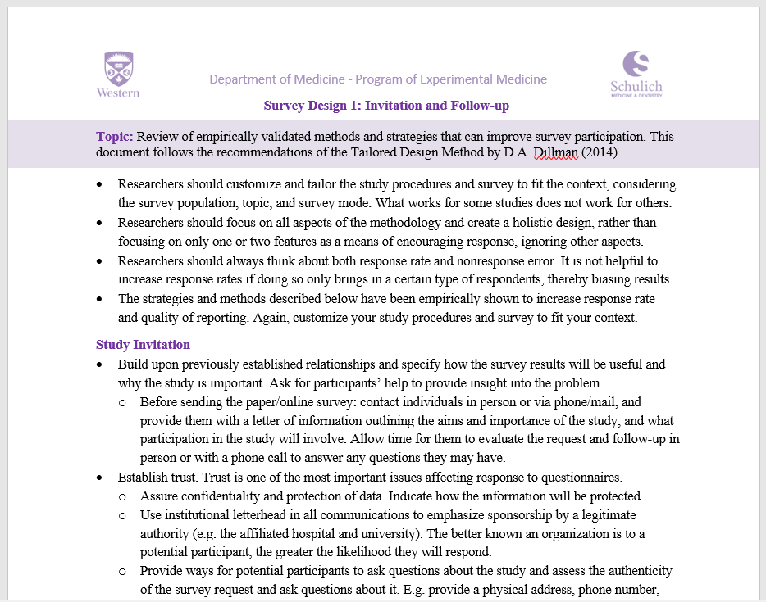
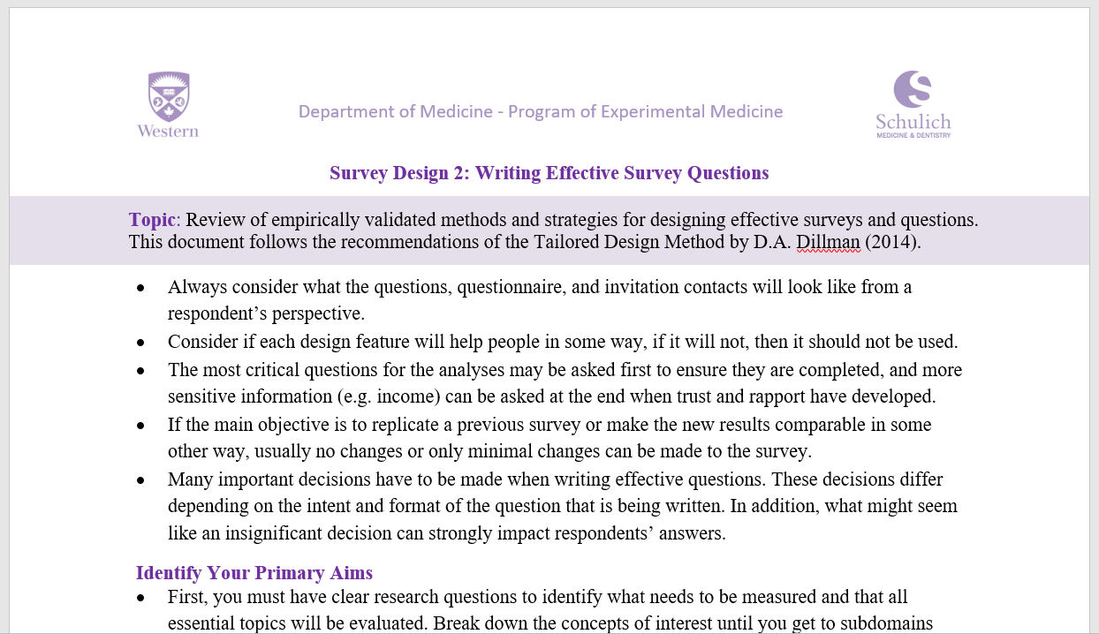

Additional Resources at POEM

Slide 15
Thank You!

